Slide 1
Accelerating Systems with Programmable Logic Components Lecture 07 Synthesis II Example Synthesizable Designs
1DT109 ASPLOC
2022 VT1-VT2
Yuan Yao, yuan.yao@it.uu.se

Slide 2
Writing synthesizable Verilog
Elements
Logic value
Variable
Constant
Parameter
Basic building blocks
Continuous assignment
Procedural assignment
Logic operator
Arithmetic operator
Relational operator
Equality operator
Shift operator
Vector operator
Always statement
If statement
Case statement
Loop statement

Slide 3
Example synthesizable designs
Example designs
Counter
Binary counter
Modulo-N counter
Johnson counter
Gray counter
A pattern detector
A factorial generator

Slide 4
Synthesis optimization techniques
Resource allocation
Common subexpression
Code revising
Code restructure
Using parentheses
Avoiding Flip-flops
Avoiding latches
Don’t depend on the EDA to do all optimizations for you.

Slide 5
Universal shift register
Model a 3-bit universal shift register which can perform the following functions:
Hold value
Shift left
Shift right
Load value
Asynchronous reset
Function | Mode |  | Outputs
 | S[0] | S[1] | Q[2] | Q[1] | Q[0]
Hold | 0 | 0 | Q[2] | Q[1] | Q[0]
Shift left | 0 | 1 | Q[1] | Q[0] | right_in
Shift right | 1 | 0 | left_in | Q[2] | Q[1]
Load | 1 | 1 | par_in[2] | par_in[1] | par_in[0]

Slide 6
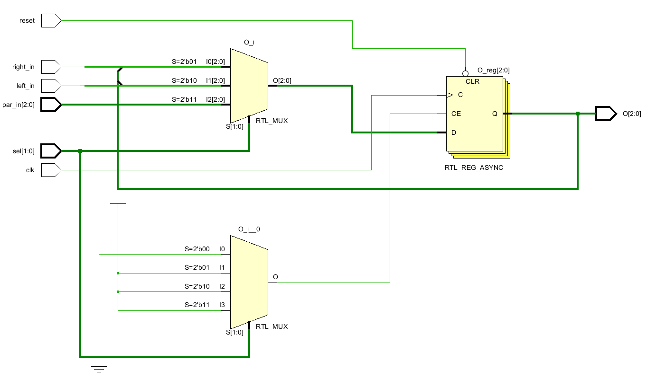
Universal shift register
module demo_1(clk, reset,
left_in, right_in, par_in,
sel, O);
input clk, reset, left_in, right_in;
input [2:0] par_in;
input [1:0] sel;
output [2:0] O;
reg [2:0] O;
always @ (posedge clk, negedge reset) begin
if (!reset)
O <= 3'b000;
else
O <= 3’b000;
case (sel)
2'b00: ;
2'b01:
O <= {O[1:0], right_in};
2'b10:
O <= {left_in, O[2:1]};
2'b11:
O <= par_in;
endcase
end
endmodule

Slide 7
Counter
Binary counter
Modulo-N counter
Johnson counter
Gray counter

Slide 8
Counter – binary counter
Model a parameterized N-bit binary up-down counter with synchronous reset and reload controls.
The counting is synchronized to the rising edge of a lock.

Slide 9
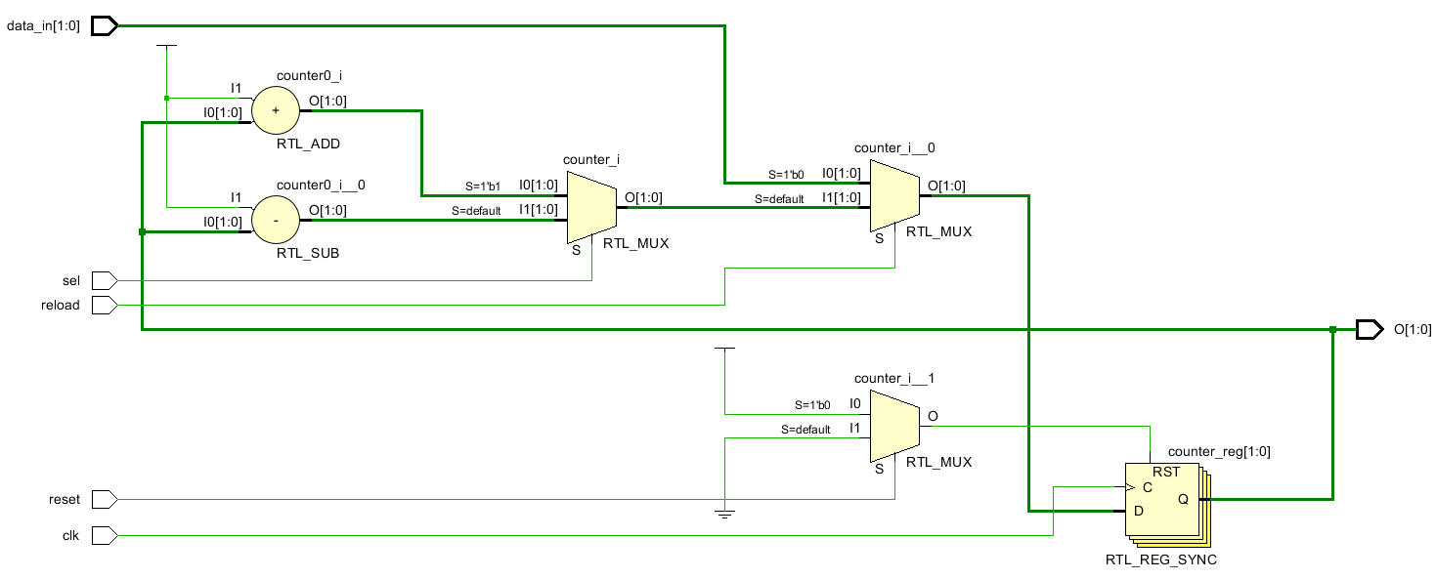
Counter – binary counter
module demo_2 (clk, reset, reload, sel,
data_in,
O);
parameter N = 2;
input clk, reset, reload, sel;
input [N-1 : 0] data_in;
output [N-1 : 0] O;
reg [N-1 : 0] counter;
assign O = counter;
always @ (posedge clk)
if (!reset)
counter <= 0;
else if (!reload)
counter <= data_in;
else if (sel)
counter <= counter + 1;
else
counter <= counter - 1;
endmodule

Slide 10
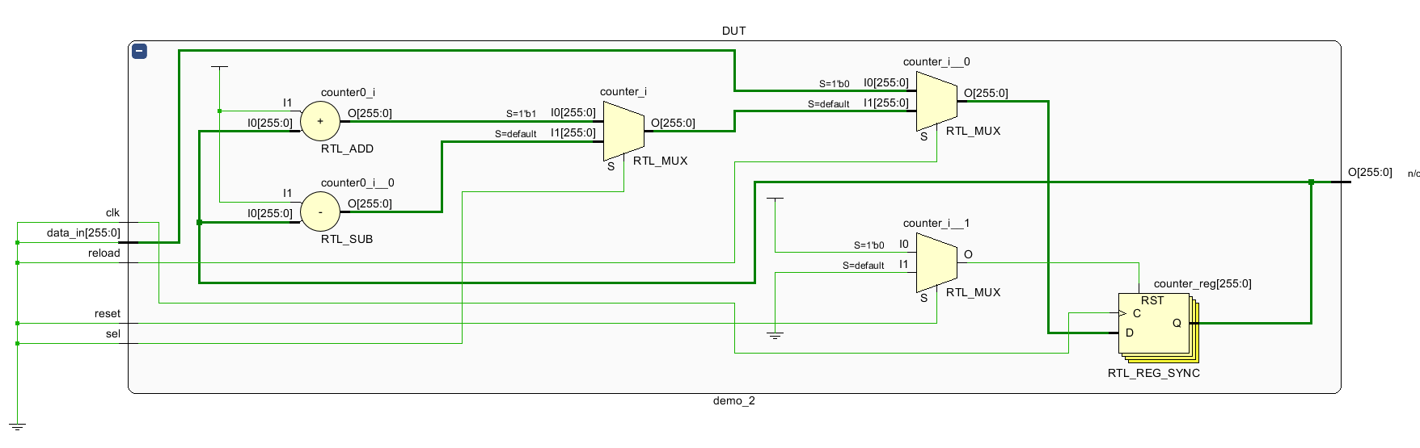
Counter – binary counter
module demo_2_tb;
parameter N = 256;
reg clk, reset, reload, sel;
reg [N-1 : 0] data_in;
wire [N-1 : 0] O;
demo_2 #N DUT(clk, reset, reload, sel,
data_in,
O);
initial begin
…
end
endmodule

Slide 11
Counter – modulo-N counter
Model a parameterized modulo-N binary up-counter with only synchronous reset control.
The counting is synchronized to the rising edge of a lock.

Slide 12
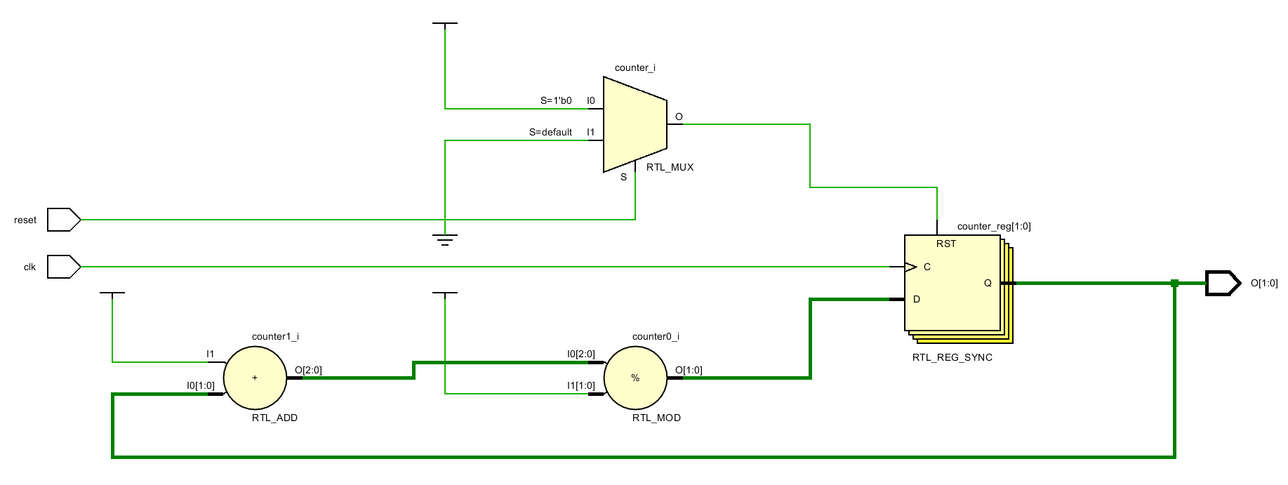
Counter – modulo-N counter
module demo_3(clk, reset, O);
parameter N = 2, M = 3;
input clk, reset;
output [N-1:0] O;
reg [N-1:0] counter;
assign O = counter;
always @ (posedge clk)
if (!reset)
counter <= 0;
else
counter <= (counter + 1) % M;
endmodule

Slide 13
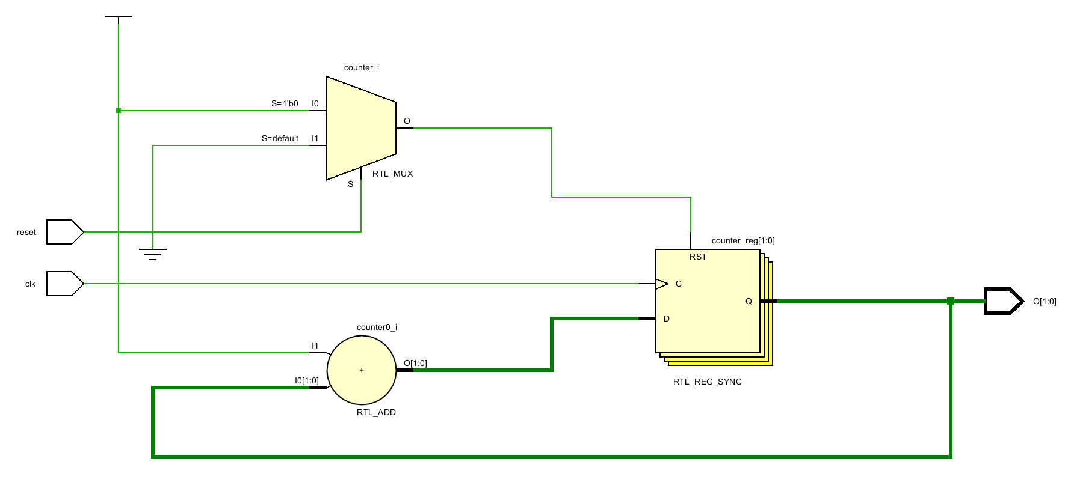
Counter – modulo-N counter
module demo_3(clk, reset, O);
parameter N = 2, M = 8;
input clk, reset;
output [N-1:0] O;
reg [N-1:0] counter;
assign O = counter;
always @ (posedge clk)
if (!reset)
counter <= 0;
else
counter <= (counter + 1) % M;
endmodule

Slide 14
Counter – Johnson counter
A Johnson counter is a shift-type counter. Here is an example of a 3-bit Johnson counter.
000
001
011
111
110
100
000
The keys to model a Johnson counter are:
If the most significant bit (the leftmost bit) of the counter is a 1, then a 0 must be shifted in from the right.
If the most significant bit is a 0, then a 1 must be shifted in from the right.

Slide 15
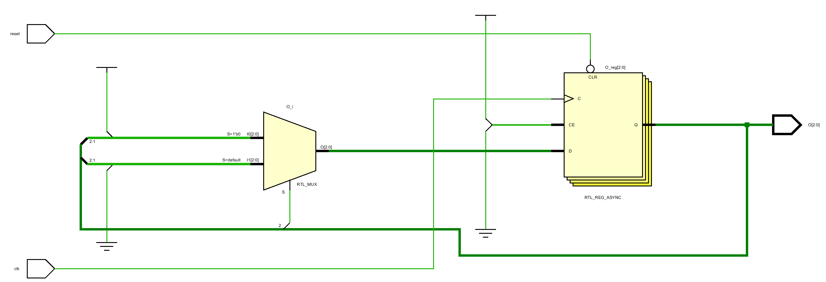
Johnson counter
module demo_4 (clk, reset, O);
parameter N = 3;
input clk, reset;
output [N-1 : 0] O;
reg [N-1 : 0] O;
always @ (posedge clk, negedge reset)
if (!reset)
O <= 0;
else begin
if (!O[N-1])
O <= {O[N-1:1], 1'b1};
else
O <= {O[N-1:1], 1'b0};
end
endmodule

Slide 16
Counter – Gray counter
Neighbor numbers in Johnson counter change 1-bit each time.
However, a lot of patterns are wasted.
A Gray counter is a binary counter in which neighbor numbers change 1-bit each time
And all number patters are utilized
Johnson
Gray
Gray
1 | 0000
2 | 0001
3 | 0011
4 | 0111
5 | 1111
6 | 1110
7 | 1100
8 | 1000
1 | 0000
2 | 0001
3 | 0011
4 | 0010
5 | 0110
6 | 0111
7 | 0101
8 | 0100
9 | 1100
10 | 1101
11 | 1111
12 | 1110
13 | 1010
14 | 1011
15 | 1001
16 | 1000
Only 8 out of 16 patterns are used

Slide 17
Counter – Gray counter
Gray
Binary
1 | 0000
2 | 0001
3 | 0011
4 | 0010
5 | 0110
6 | 0111
7 | 0101
8 | 0100
1 | 0000
2 | 0001
3 | 0010
4 | 0011
5 | 0100
6 | 0101
7 | 0110
8 | 0111
Generating Gray code from binary bit
The first Gray bit is the same as the first binary bit
9 | 1100
10 | 1101
11 | 1111
12 | 1110
13 | 1010
14 | 1011
15 | 1001
16 | 1000
9 | 1000
10 | 1001
11 | 1010
12 | 1011
13 | 1100
14 | 1101
15 | 1110
16 | 1111
All patterns are used

Slide 18
Counter – Gray counter
Gray
Binary
1 | 0 0 0 0
2 | 0 0 0 1
3 | 0 0 1 1
4 | 0 0 1 0
5 | 0 1 1 0
6 | 0 1 1 1
7 | 0 1 0 1
8 | 0 1 0 0
1 | 0 0 0 0
2 | 0 0 0 1
3 | 0 0 1 0
4 | 0 0 1 1
5 | 0 1 0 0
6 | 0 1 0 1
7 | 0 1 1 0
8 | 0 1 1 1
Generating Gray code from binary bit
The first Gray bit is the same as the first binary bit
9 | 1 1 0 0
10 | 1 1 0 1
11 | 1 1 1 1
12 | 1 1 1 0
13 | 1 0 1 0
14 | 1 0 1 1
15 | 1 0 0 1
16 | 1 0 0 0
9 | 1 0 0 0
10 | 1 0 0 1
11 | 1 0 1 0
12 | 1 0 1 1
13 | 1 1 0 0
14 | 1 1 0 1
15 | 1 1 1 0
16 | 1 1 1 1

Slide 19
Counter – Gray counter
XOR
Gray
Binary
1 | 0 0 0 0
2 | 0 0 0 1
3 | 0 0 1 1
4 | 0 0 1 0
5 | 0 1 1 0
6 | 0 1 1 1
7 | 0 1 0 1
8 | 0 1 0 0
1 | 0 0 0 0
2 | 0 0 0 1
3 | 0 0 1 0
4 | 0 0 1 1
5 | 0 1 0 0
6 | 0 1 0 1
7 | 0 1 1 0
8 | 0 1 1 1
Generating Gray code from binary bit
The first Gray bit is the same as the first binary bit
The second Gray bit is determined by XOR’ing the first binary bit with the second binary bit.
9 | 1 1 0 0
10 | 1 1 0 1
11 | 1 1 1 1
12 | 1 1 1 0
13 | 1 0 1 0
14 | 1 0 1 1
15 | 1 0 0 1
16 | 1 0 0 0
9 | 1 0 0 0
10 | 1 0 0 1
11 | 1 0 1 0
12 | 1 0 1 1
13 | 1 1 0 0
14 | 1 1 0 1
15 | 1 1 1 0
16 | 1 1 1 1

Slide 20
Counter – Gray counter
XOR
Gray
Binary
1 | 0 0 0 0
2 | 0 0 0 1
3 | 0 0 1 1
4 | 0 0 1 0
5 | 0 1 1 0
6 | 0 1 1 1
7 | 0 1 0 1
8 | 0 1 0 0
1 | 0 0 0 0
2 | 0 0 0 1
3 | 0 0 1 0
4 | 0 0 1 1
5 | 0 1 0 0
6 | 0 1 0 1
7 | 0 1 1 0
8 | 0 1 1 1
Generating Gray code from binary bit
The first Gray bit is the same as the first binary bit
The second Gray bit is determined by XOR’ing the first binary bit with the second binary bit.
Repeat the same algorithm for each pair of adjacent binary bits to get the corresponding Gray bits
9 | 1 1 0 0
10 | 1 1 0 1
11 | 1 1 1 1
12 | 1 1 1 0
13 | 1 0 1 0
14 | 1 0 1 1
15 | 1 0 0 1
16 | 1 0 0 0
9 | 1 0 0 0
10 | 1 0 0 1
11 | 1 0 1 0
12 | 1 0 1 1
13 | 1 1 0 0
14 | 1 1 0 1
15 | 1 1 1 0
16 | 1 1 1 1

Slide 21
Counter – Gray counter
XOR
Gray
Binary
1 | 0 0 0 0
2 | 0 0 0 1
3 | 0 0 1 1
4 | 0 0 1 0
5 | 0 1 1 0
6 | 0 1 1 1
7 | 0 1 0 1
8 | 0 1 0 0
1 | 0 0 0 0
2 | 0 0 0 1
3 | 0 0 1 0
4 | 0 0 1 1
5 | 0 1 0 0
6 | 0 1 0 1
7 | 0 1 1 0
8 | 0 1 1 1
Generating Gray code from binary bit
The first Gray bit is the same as the first binary bit
The second Gray bit is determined by XOR’ing the first binary bit with the second binary bit.
Repeat the same algorithm for each pair of adjacent binary bits to get the corresponding Gray bits
9 | 1 1 0 0
10 | 1 1 0 1
11 | 1 1 1 1
12 | 1 1 1 0
13 | 1 0 1 0
14 | 1 0 1 1
15 | 1 0 0 1
16 | 1 0 0 0
9 | 1 0 0 0
10 | 1 0 0 1
11 | 1 0 1 0
12 | 1 0 1 1
13 | 1 1 0 0
14 | 1 1 0 1
15 | 1 1 1 0
16 | 1 1 1 1

Slide 22
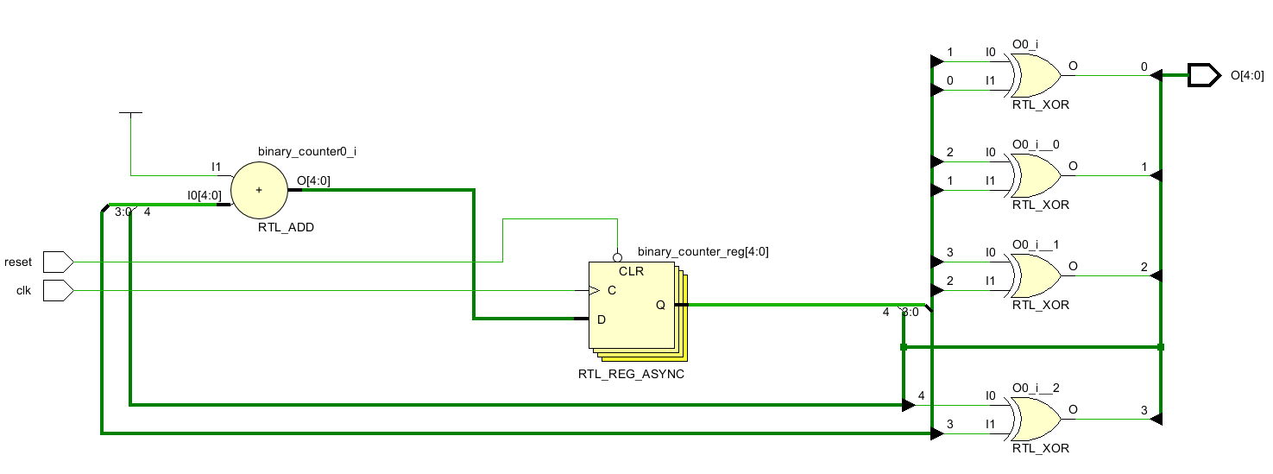
Counter – Gray counter
module demo_5 (clk, reset, O);
parameter N = 4;
input clk, reset;
output [N-1:0] O;
reg [N-1:0] binary_counter, gray;
assign O = gray;
always @ (posedge clk or negedge reset)
if (!reset)
binary_counter <= 0;
else
binary_counter <= binary_counter + 1;
integer i;
always @ (binary_counter) begin
gray[N-1] = binary_counter[N-1];
for (i=0; i<N-1; i=i+1)
gray[i] = binary_counter[i+1] ^ binary_counter[i];
end
endmodule
module demo_5_tb;
parameter N = 5;
wire [N-1:0] O;
reg clk;
reg reset;
initial begin
clk = 1'b0;
reset = 1'b1;
#1 reset = 1'b0;
#1 reset = 1'b1;
end
always #5 clk = ~clk;
demo_5 #N DUT (clk, reset, O);
endmodule

Slide 23
A pattern detector
Model a logic to detect ‘111’ (consecutive three 1’s) in a data stream appearing on serial input Data.
The input is checked on every rising edge of clock.
If ‘111’ is found on the input, the output is set to true.
Otherwise, it is set to false.

Slide 24

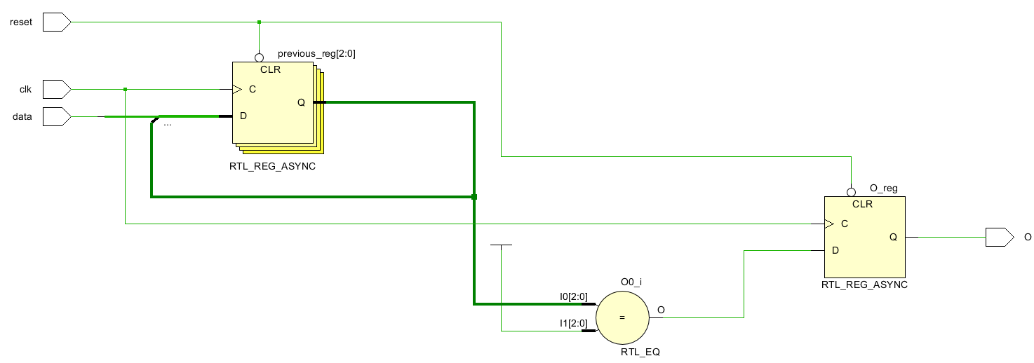
A pattern detector
module demo_6 (clk, reset, data, O);
input clk, reset, data;
output O;
reg O;
parameter PATTERN = 3'b111;
reg [2:0] previous;
always @ (posedge clk, negedge reset)
if (!reset) begin
previous <= 3'b000;
O <= 1'b0;
end else begin
previous <= {previous[1:0], data};
O <= (previous == PATTERN);
end
endmodule
Note there are two FF inferred from the same always.
Think why is that.
How to get rid of that.

Slide 25

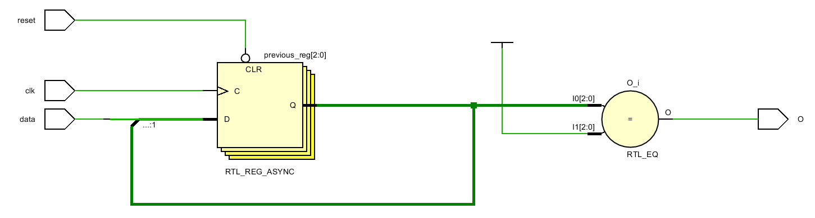
A pattern detector
module demo_7 (clk, reset, data, O);
input clk, reset, data;
output O;
reg O;
parameter PATTERN = 3'b111;
reg [2:0] previous;
assign O = (previous == PATTERN);
always @ (posedge clk, negedge reset)
if (!reset) begin
previous <= 3'b000;
O <= 1'b0;
end else begin
previous <= {previous[1:0], data};
O <= (previous == PATTERN);
end
endmodule
Only one set of FF

Slide 26
A factorial generator
Model a 5-bit factorial generator that calculates the factorial of a number given in Data.
The result is output in Result and Exponent as mantissa and exponent, respectively.
The exponent is base-2.

Slide 27
A factorial generator
Why 5 is enough?
inter presentation should be larger than 31x255
Trim to 8-bit output
Precision loss
Factorial generator
data
(5-bit)
Seq-logic
Combi-logic
integer reg_data
reg_result
always @ clk
reg_result <= reg_result * reg_data;
reg_data <=
reg_data - 1;
result
(8-bit)
for (i=0; i<5; i=i+1) begin
if (reg_result > 255) begin
reg_result = reg_result >> 1;
reg_exponent = reg_exponent + 1;
end
end
?-bit
reg_result
reset
exponent
(7-bit)
?-bit
clk
31! ≈ 82 × 10³² ≈ 202 × 2¹⁰⁵
8-bit
7-bit

Slide 28
A factorial generator – module declaration
module demo_8 (clk, reset,
data,
done, result, exponent);
input clk, reset;
input [4:0] data;
output [7:0] result;
output [6:0] exponent;
output done;
integer reg_result, reg_exponent;
reg reg_done;
assign result = reg_result;
assign exponent = reg_exponent;
assign done = reg_done;
reg [4:0] reg_data;
integer i;
Factorial generator
data
(5-bit)
result
(8-bit)
reset
exponent
(7-bit)
clk
done

Slide 29
A factorial generator – seq-logic
Default set to ‘b1
0!, 1!
Seq-logic
Factorial generator
always @ (posedge clk, negedge reset) begin:
if (!reset) begin
reg_done <= 'b0;
reg_result <= 'b1;
reg_exponent <= 'b0;
reg_data <= data;
end else begin
if (!reg_done) begin
reg_result <= reg_result * reg_data;
reg_data <= reg_data - 1;
end
end
end
reg_data
*
reg_result
data
(5-bit)
result
(8-bit)
-
reg_exp
exponent
(7-bit)
reset
reg_done
clk
done

Slide 30
A factorial generator – seq-logic
Factorial generator
Seq-logic
Combi-logic
always @ (reg_data, reg_result) begin
if (reg_data <= 1)
reg_done = 'b1;
else
reg_done = 'b0;
for (i=0; i<5; i=i+1) begin
if (reg_result > 255) begin
reg_result = reg_result >> 1;
reg_exponent = reg_exponent + 1;
end
end
end
reg_data
reg_result
>>
data
(5-bit)
*
mantissa
(8-bit)
>
-
reg_exp
exponent
(7-bit)
reset
+
reg_done
clk
done

Slide 31
Synthesis optimization techniques
Resource allocation
Common subexpression
Code revising
Code restructure
Using parentheses
Avoiding Flip-flops
Avoiding latches
Don’t depend on the EDA to do all optimizations for you.

Slide 32
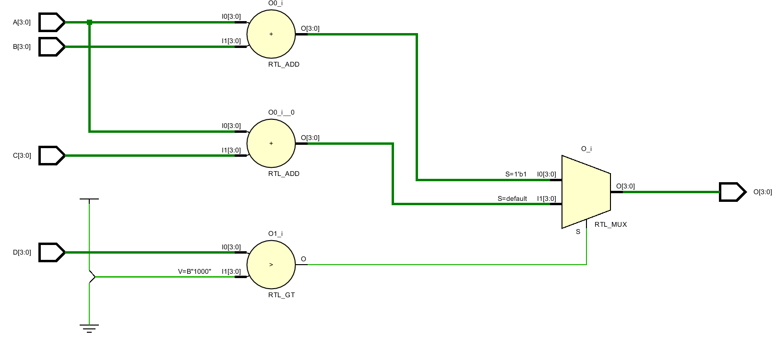
Resource allocation
Resource allocation refers to the process of sharing an arithmetic logic unit (ALU) under mutually-exclusive conditions.
Consider the following if statement
Critical path of the logic goes through 2 components. This affects how fast the logic can run.
module demo_9(A, B, C, D, O);
input [3:0] A, B, C, D;
output [3:0] O;
reg [3:0] O;
always @ (A, B, C, D)
if (D > 8)
O = A + B;
else
O = A + C;
endmodule
How many ALUs are we using?

Slide 33
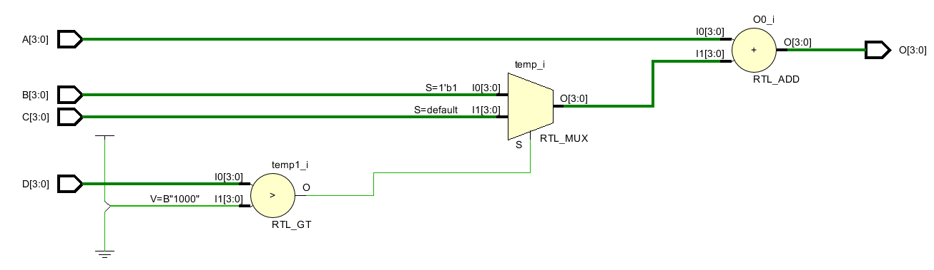
Resource allocation
The if-statement is mutual exclusive
module demo_10(A, B, C, D, O);
input [3:0] A, B, C, D;
output [3:0] O;
reg [3:0] O;
always @ (A, B, C, D) begin: demo_10_always
reg [3:0] temp;
if (D > 8)
temp = B;
else
temp = C;
O = A + temp;
end
endmodule
We can write our code in a smarter way so that only one ALU is enough.
Beware of the area/speed tread-off when doing resource allocation.
Save one adder!
Critical path of the logic goes through 3 components. Will run slower than the previous design.

Slide 34
Common subexpression
It is often useful in practice to identify common subexpression and to reuse computed values where possible.
Will synthesis with 3 adders.
A = B + C;
D = E – B – C;
A = B + C;
D = E – A;
Save 1 adder.
if (A)
B = E&(C+D)
else
B = E^(C+D)
temp = C+D
if (A)
B = E&temp
else
B = E^temp
Will synthesis with 2 adders.
Save 1 adder.
Will synthesis with 4 adders.
O1 = A + B + C
O2 = C + A – B
temp = A + C
O1 = temp + B
O2 = temp – B
Save 1 adder.

Slide 35
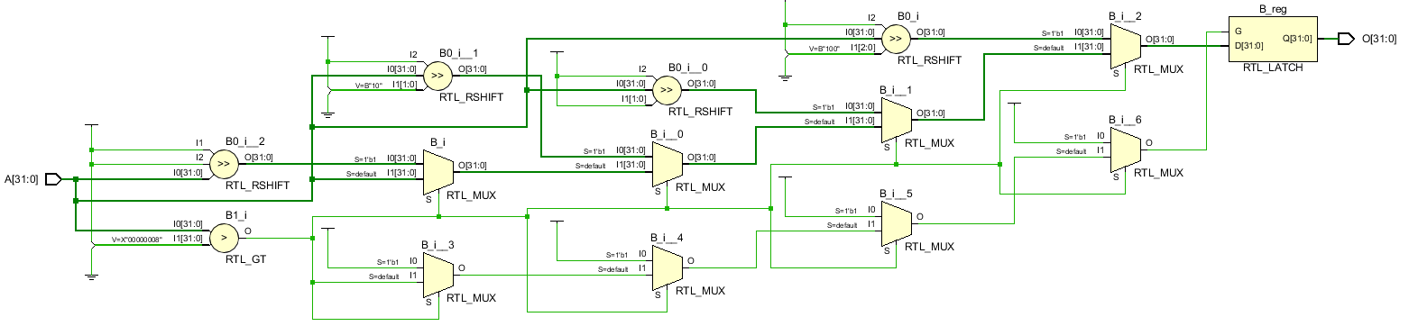
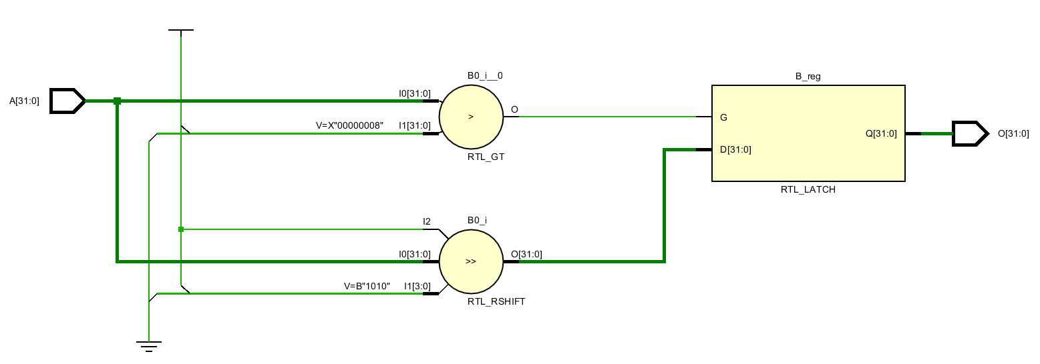
Code revising
In many cases within a for-loop statement, there is an expression whose value does not change, or change by a fixed pattern through every iteration of the loop.
module demo_11(A, O);
input [31:0] A;
output [31:0] O;
integer i;
reg [31:0] B;
always @ (A)
for(i=0; i<5; i=i+1)
if (A > 8)
B = A >> i;
assign O = B;
endmodule
module demo_12(A, O);
input [31:0] A;
output [31:0] O;
integer i;
reg [31:0] B;
always @ (A)
if (A > 8)
B = A >> 10;
assign O = B;
endmodule
How many ALUs are we using?

Slide 36
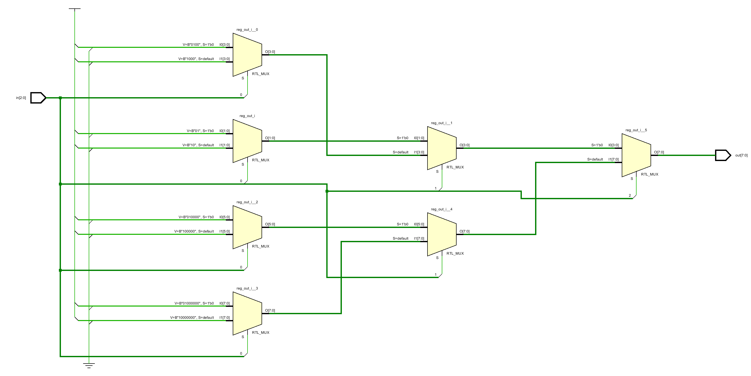
Code restructure
always @ (in) begin
if (in[2] == 1'b0)
if(in[1] == 1'b0)
if(in[0] == 1'b0)
reg_out = 8'h0_1;
else
reg_out = 8'h0_2;
else // in[1] == 1’b1
if(in[0] == 1'b0)
reg_out = 8'h0_4;
else
reg_out = 8'h0_8;
else
if(in[1] == 1'b0)
if(in[0] == 1'b0)
reg_out = 8'h1_0;
else
reg_out = 8'h2_0;
else // in[1] == 1’b1
if(in[0] == 1'b0)
reg_out = 8'h4_0;
else
reg_out = 8'h8_0;
end //demo_12 _Verilog_3
always @ (in) begin
if (in == 3'b000)
reg_out = 8'h0_1;
else if (in == 3'b001)
reg_out = 8'h0_2;
else if (in == 3'b010)
reg_out = 8'h0_4;
else if (in == 3'b011)
reg_out = 8'h0_8;
else if (in == 3'b100)
reg_out = 8'h1_0;
else if (in == 3'b101)
reg_out = 8'h2_0;
else if (in == 3'b110)
reg_out = 8'h4_0;
else
reg_out = 8'h8_0;
end // demo_11_Verilog_3
We can also do code restructuring to make your design more balanced

Slide 37
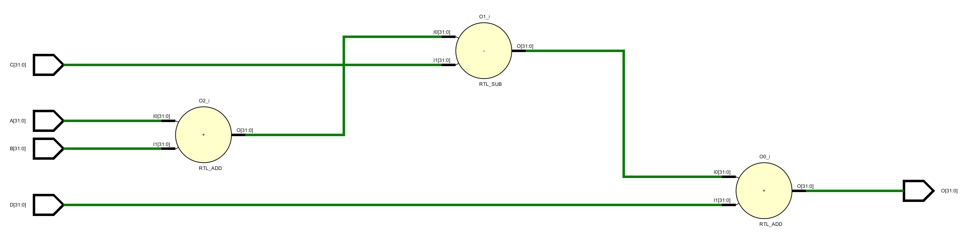
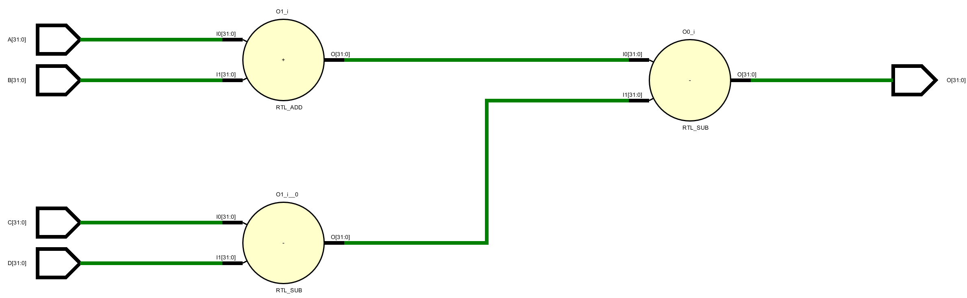
Using parentheses
Without parenthesis
Critical path of the logic goes through 3 ALUs.
When writing Verilog code, the designer must be aware of the logic structure being generated.
Use parentheses to avoid unbalanced hardware structure.
module demo_13(A, B, C, D, O);
input [31:0] A, B, C, D;
output [31:0] O;
reg [31:0] O;
always @ (A, B, C, D)
O = A + B - C + D;
endmodule
module demo_14(A, B, C, D, O);
input [31:0] A, B, C, D;
output [31:0] O;
reg [31:0] O;
always @ (A, B, C, D)
O = (A + B) – (C – D);
endmodule
With parenthesis
Critical path of the logic goes through 2 ALUs.

Slide 38
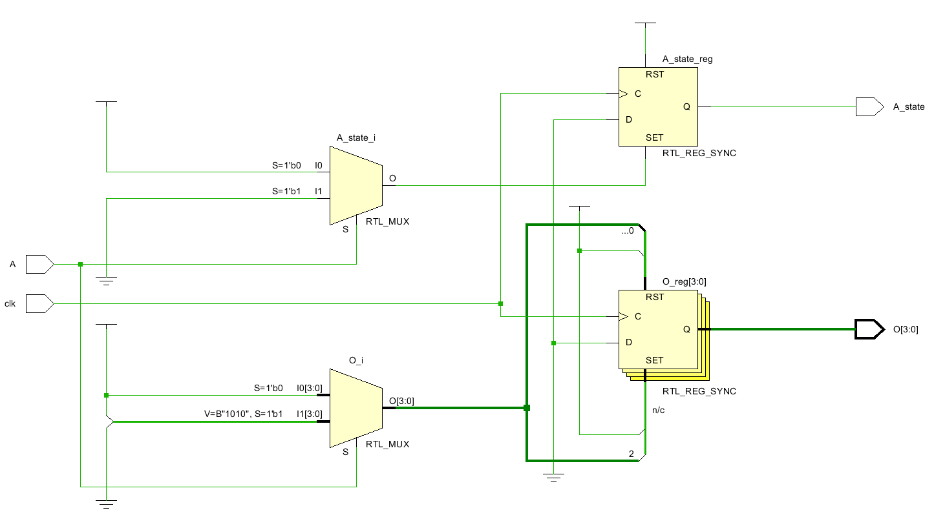
Avoiding unnecessary Flip-flops
module demo_15( A, A_state, O, clk );
input A, clk;
output [3:0] O;
reg [3:0] O;
output A_state;
reg A_state;
always @ (posedge clk)
case (A)
0: begin
A_state <= 1;
O <= 4'b0100;
end
1: begin
A_state <= 0;
O <= 4'b0001;
end
endcase
endmodule
Be careful when doing assignment in sequential logic, otherwise unnecessary flip-flops can be generated.
Remember that the purpose of FF is to store data between clock edges.
O is generated within seq-logic, using however no data within the logic.
Unnecessary FFs

Slide 39
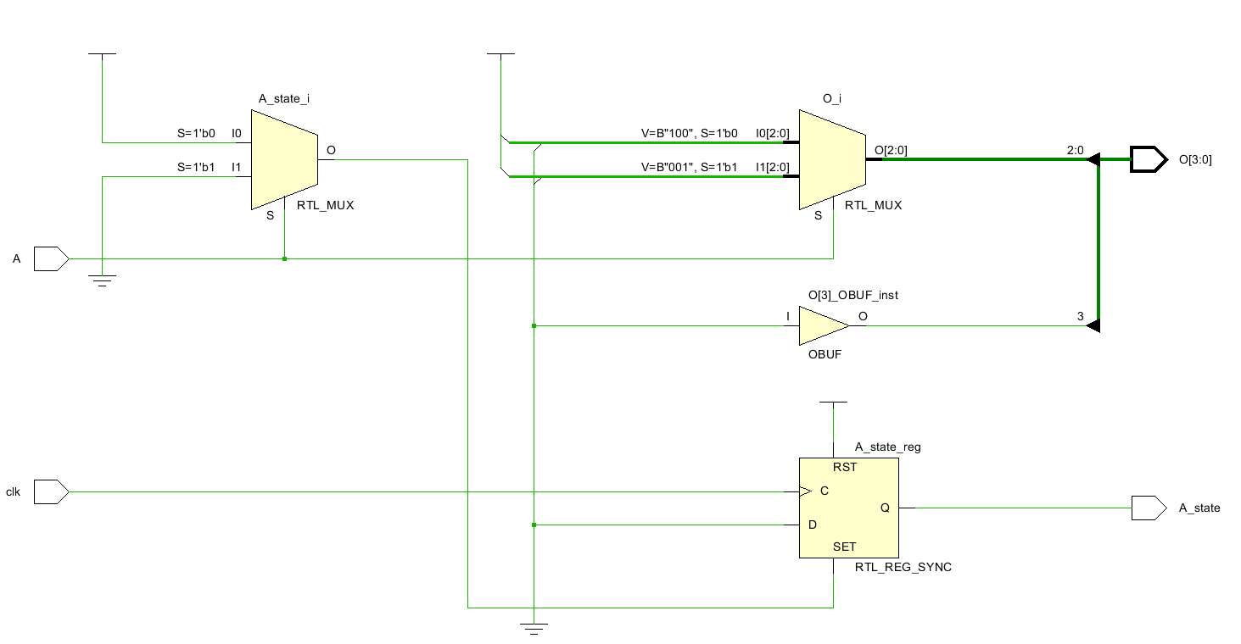
Avoiding unnecessary Flip-flops
module demo_16(
A, A_state, O, clk
);
…
always @ (posedge clk)
case (A)
0:
A_state <= 'b1;
1:
A_state <= 'b0;
endcase
always @ (A)
case (A)
0:
O = 4'b0100;
1:
O = 4'b0001;
endcase
endmodule
Remember that the purpose of combi-logic is to process data.
Seq-logic can be viewed as combi-logic + FF.
Use two always blocks
No unnecessary FF generated.

Slide 40
Avoiding unnecessary latches
Latches are essentially asynchronous storage.
In a good design, we want our logic to be fully synchronous, meaning that all storage elements (like FF's) are all clocked from a single clock source.
Anything that is asynchronous to that clock needs to be treated very carefully otherwise timing errors will occur.
Assign the same variable across all branches in if- and case-statements.

Slide 41

Questions?

